Slide 1
Wildfire Detection Systems

Slide 2
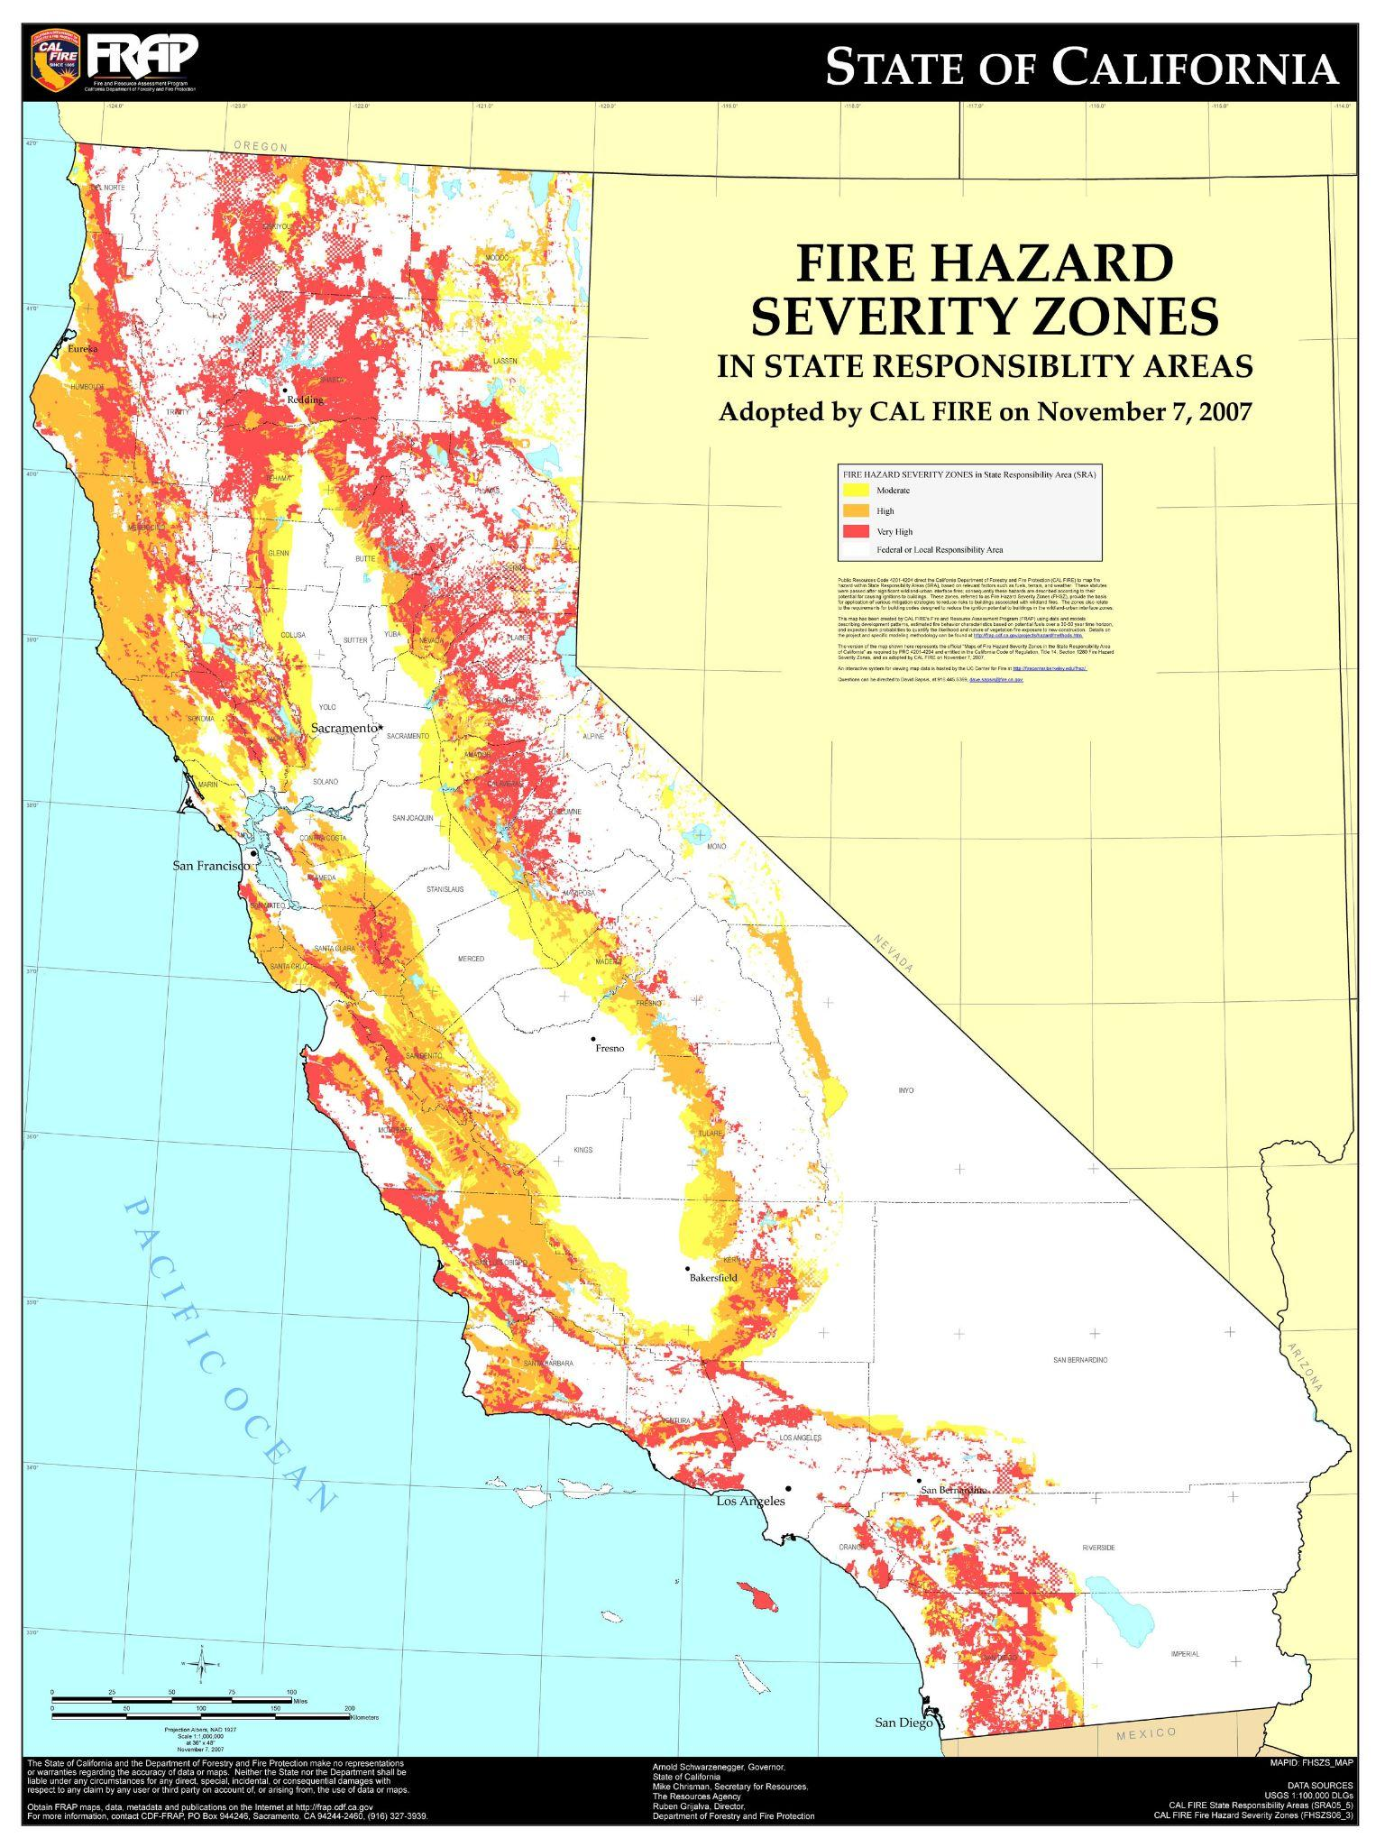
INTRODUCTION
PROPOSED TECHNICAL APPROACH
EXPECTED PROJECT RESULTS
SCHEDULE

Slide 3
Introduction
Climate change is increasing the temperatures throughout the world. Due to the gradual increase in heat, wildfires occur more frequently in areas prone to them. California is an area commonly affected by wildfires due to their already hot climate. Our objective is to design a unique detection system to pick up on these wildfires before they spread, that way firefighters can easily and safely put them out. Specifically, we are looking at Topanga State Park in Los Angeles because it is very close to homes and it is known for its wildfires. The expected benefits of this project will be reducing the damages done by wildfires and potentially saving lives.

Slide 4
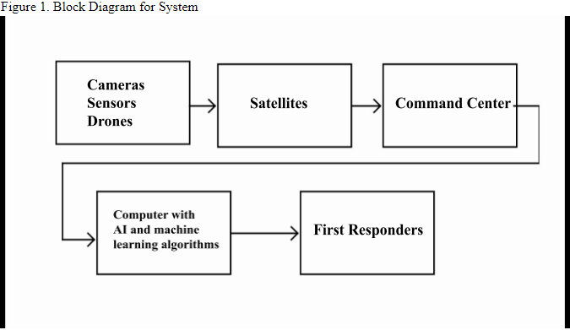
Proposed technical approach
The development and construction of the wildfire detection system will be split between 2 teams of engineers. Electrical engineers and computer scientists. They will install the following technologies
Hardware: Fire Camera, Fire sensors, Drones
Software: Computers running AI and machine learning algorithms.
Network: Communication over existing satellites.

Slide 5
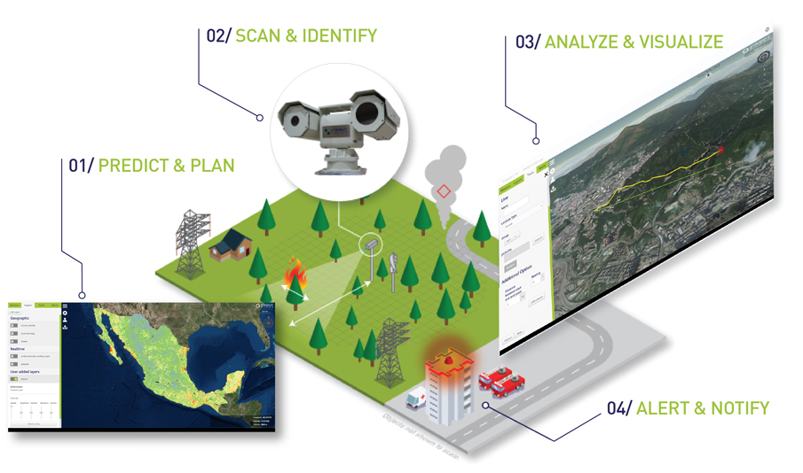

Slide 6
Quality assurance
To deliver a successful and effective system it is necessary to test and adjust. Some risks with the system can be dirty or damaged cameras, faulty sensors, satellite failure or blockage.
To test the system we use a a multipoint inspection that is performed regularly:
Cameras
Sensors
Satellite communication
Computer software
Backup power
This inspection and test ensures that each component is working properly and allows for a complete and functioning system to be delivered 24/7. The software is outfitted with a fail-safe feature that can monitor the component and can alert if there is something out of ordinary.

Slide 7
Expected project results
An increased range from 25 miles to 30 miles.
A faster detection speed
Less reliance on human reports
Lower cost in making the product
More fires detected overall

Slide 8
Schedule
Time used | Task
3 Weeks | Forest Survey - Collect information on the forest and its geography.
2 weeks | Pick hardware and design a method of detection.
2 weeks | Install Hardware
2 weeks | Set up a command center in the preselected building and install the computers and software running AI and machine learning algorithms.
2-3 days | Connect the hardware to the network and then to the software
2 weeks | System testing and multipoint inspection.

Slide 9
References
Alkhatib, A. A. A. (2006, June 1). A review on forest fire detection techniques - Ahmad A. A. Alkhatib, 2014. SAGE Journals. Retrieved November 18, 2021, from https://journals.sagepub.com/doi/full/10.1155/2014/597368.
Lowe, J. (2021, June 19). 'if you move out here, you make a deal with nature': Life in a fire-prone canyon. The New York Times. Retrieved November 18, 2021, from https://www.nytimes.com/2021/06/19/us/topanga-canyon-wildfires.html.
California Department of Forestry and Fire Protection (CAL FIRE). (2021). Stats and events. Cal Fire Department of Forestry and Fire Protection. Retrieved November 18, 2021, from https://www.fire.ca.gov/stats-events/.
Insight Robotics wildfire detection system. Insight Robotics. (2019, November 6). Retrieved November 18, 2021, from https://www.insightrobotics.com/en/services/wildfire-detection-system/. Topanga Fire. DBpedia. (2005). Retrieved November 18, 2021, from http://live.dbpedia.org/resource/Topanga_Fire.
Wildfire Statistics - Federation of American scientists. (n.d.). Retrieved November 8, 2021, from https://sgp.fas.org/crs/misc/IF10244.pdf

